Slide 1
Cancer Biology Biol 445
Spring 2020
Dr. Heidi Super
Lecture 14
2-26-2020

Slide 2
Quiz 2 returned
Any ideas/interest in service projects?

Slide 3
Where did we leave off?
Cellular proto-oncogenes can acquire gain of function in 4 ways:
Describe them. Give an example
We located and identified many oncogenes because cancer cells had abnormal versions of the genes.
For example, MYC oncogene was contained within the amplified DNA regions in some types of cancer cells.
MYC is also transferred to a non-homologous chromosome in some type of leukemias and lymphomas

Slide 4
HSR including the MYC gene in childhood neural cancer (neuroblastoma).
The bright color indicates where a florescent DNA probe forms complementary base pairs with MYC gene sequence.
Technique called fluorescence in situ hybridization or FISH.

Slide 5
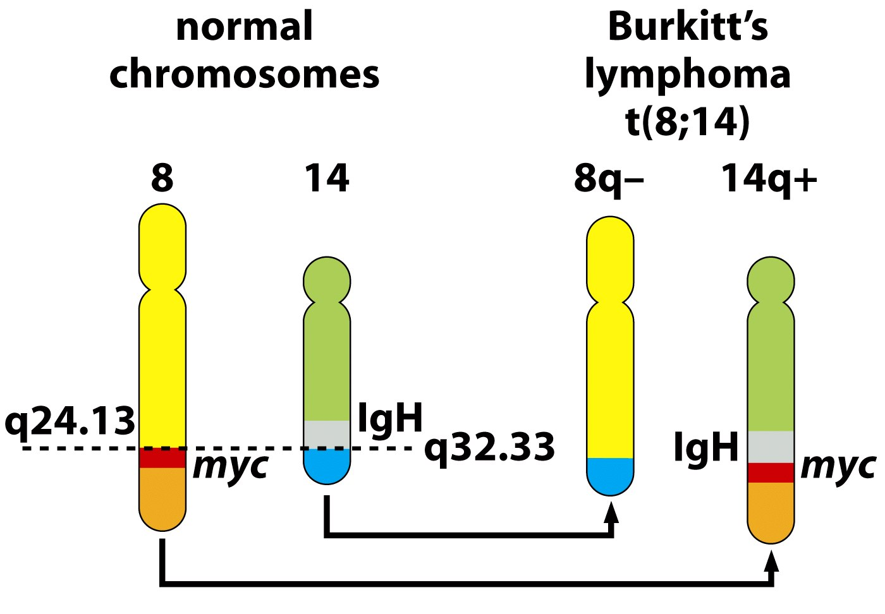
Figure 4.13a The Biology of Cancer (© Garland Science 2007)

Slide 6
Pretty compelling evidence that MYC is important in cellular health and that altered MYC is a molecular driver of cancer.

Slide 7
Lets review…one last mechansims for turning a cellular protooncogene into an oncogene
4. Insertional mutagenesis---
Again, virus-caused cancers are rare in humans but common in some animals. In both non-human animals and humans, viruses can disrupt cellular genes by inserting into the DNA.
Some cancer-causing viruses don’t carry their own oncogenes.
But….they alter the host’s genes by inserting their genome into the host’s DNA, sometimes landing in/near proto-oncogenes in the host DNA.

Slide 8
The proximity to the cellular proto-oncogene can cause it to be up-regulated.
Ca
Mechanism for gain of function mutation

Slide 9
Examples
Avian Leukosis virus carries no oncogenes, but inserts into the MYC gene, causing increased expression of MYC in white blood cells in birds. (There’s MYC again!)
Murine (mouse) leukemia viruses—insert into various host cell genes resulting in leukemia.

Slide 10
After insertion, they are very efficient at initiating gene expression (transcription) (attracting RNA polymerase).
The effect spills over to nearby DNA regions of DNA causing nearby genes to be transcribed like crazy.

Slide 11
Retroviruses are often used in research to get a new gene into an organism’s genome.
Sometimes the goal is to create/locate oncogenes or induce abnormal gene expression related to cancer in lab models.
Sometimes the goal is different –
Development of transgenic organisms—organisms carrying a gene they don’t normally have.
Development of gene therapy approaches

Slide 12
Gene therapy---risky business…
Inadvertent /unintended insertion of a transgene into/near an oncogene results in cancer in an experimental animal.
Gene therapy with inserting viruses increases the patients risk for cancer. (by insertion of therapeutic gene near oncogenes).

Slide 13
Let’s get specific
What are the proteins produced by proto-oncogenes and oncogenes?

Slide 14
Several categories
Growth factors
Growth factor receptors
G-proteins
Cytoplamic kinases
Transcription factors
Cell cycle or cell death proteins

Slide 15
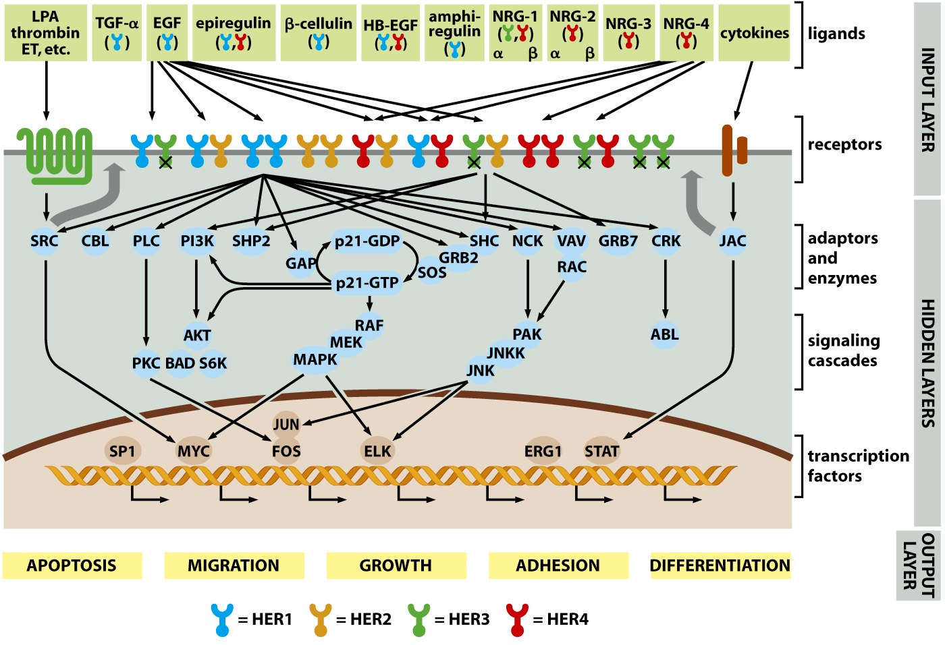

Slide 16
Recall signal transduction
Lets return to the RAS gene/Ras protein
Ras has a role in a common cell division activating signal transduction pathway.
Ras protein acts in the middle of a complex cascade of proteins which become activated in response to mitogens.

Slide 17
A mitogen is any factor which induces proliferation of a cell. Mitogens are one type of growth factor.
Ras is activated after a mitogen binds its receptor and can “talk” to/through different proteins to activate proliferation

Slide 18
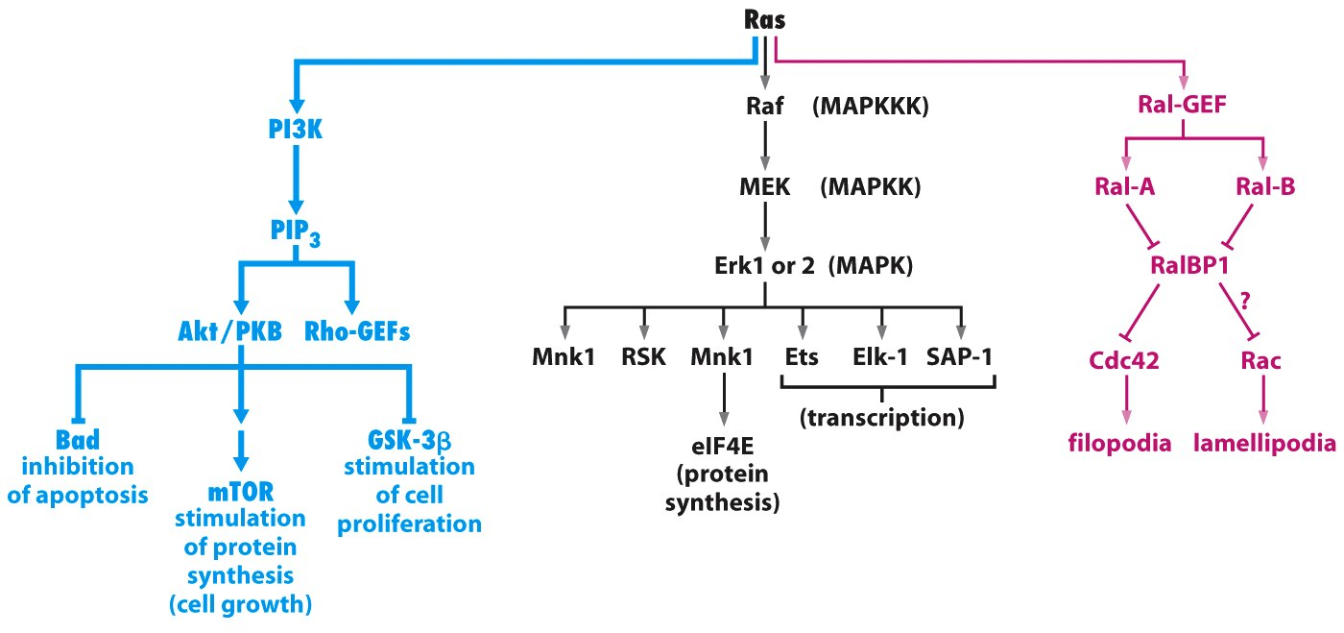
Figure 6.15 The Biology of Cancer (© Garland Science 2007)

Slide 19
Ras-MAPK pathway is discussed in your text
Figure 6.15 The Biology of Cancer (© Garland Science 2007)

Slide 20
MAPK=Mitogen Activated Protein Kinase.
MAPKK=MAPK kinase
MAPKKK=?

Slide 21
MAPK=Mitogen Activated Protein Kinase.
MAPKK=MAPK kinase
MAPKKK=MAPK kinase kinase!
--In the Ras signal cascade there are many successive phosphorylation events

Slide 22
Signal transduction involving Ras proteins starts with cell surface receptors binding a growth factor (GF).

Slide 23
Examples of Mitogen growth factors
Platelet-derived growth factor (PDGF)
Released by platelets. Stimulates growth of connective tissue. Important in wound healing.
Epidermal growth factor (EGF)
Released by many cell types. Stimulates growth of epithelial cells and other cell types.

Slide 24
Both PDGF and EGF are found in blood serum.
Serum was/is used as a general source of GFs before any specific GF was purified and identified.

Slide 25
Binding of a mitogen (like PDGF or EGF) usually causes autophosphorylation of the receptor.
This occurs on the receptors’ cytoplasmic portion—which is conserved in many type of GF receptors. A specific tyrosine gets phosphorylated in response to binding of a specific GF.

Slide 26
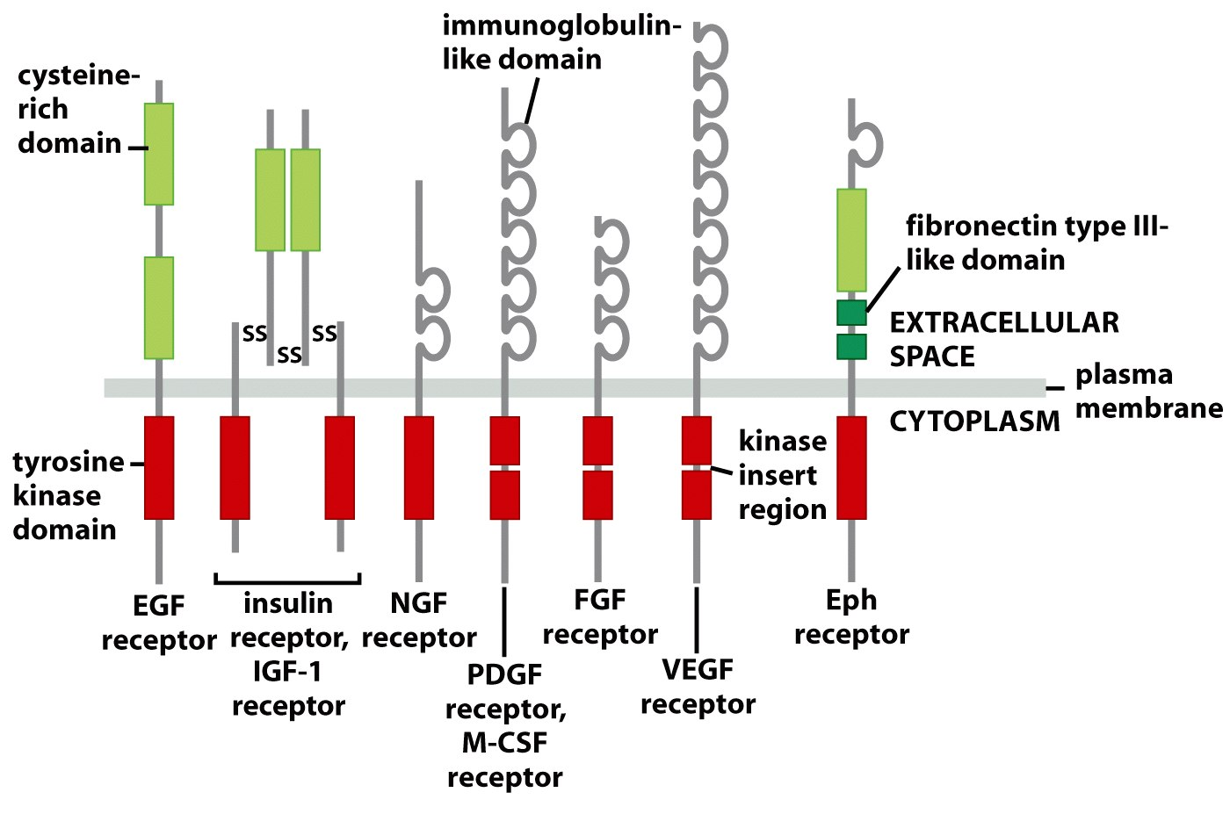
Some receptor tyrorine kinases
Figure 5.10 The Biology of Cancer (© Garland Science 2007)

Slide 27
Figure 5.10 The Biology of Cancer (© Garland Science 2007)

Slide 28
A common signal which activates the tyrosine protein kinase is dimerization of individual receptors.

Slide 29
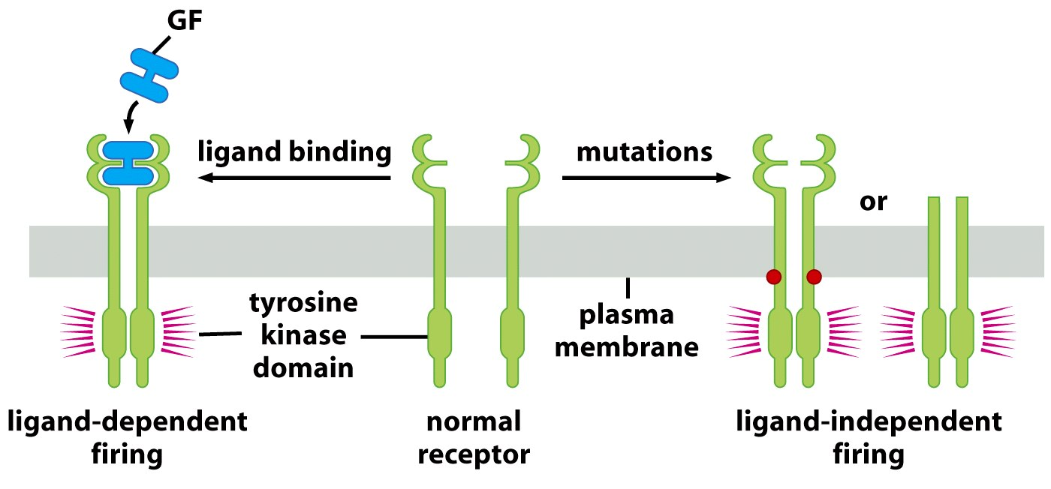
“ligand” is something that binds a receptor
Figure 5.12a The Biology of Cancer (© Garland Science 2007)

Slide 30
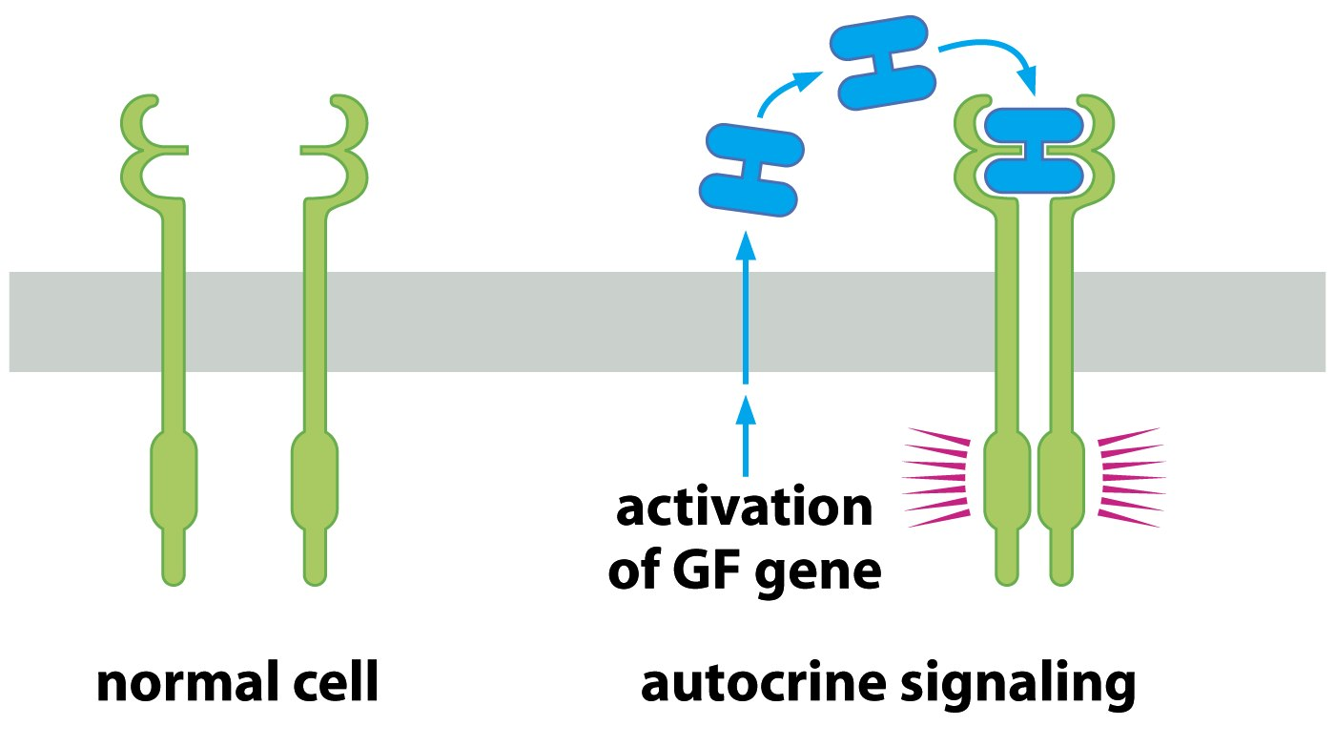
GF released by other cells=paracrine signaling.
Figure 5.12b The Biology of Cancer (© Garland Science 2007)

Slide 31
Other receptors require a different tyrosine kinase to phosphorylate them.
Jak-STAT pathway.
Jak is not part of the receptor, but is required to phosphoylate the receptor.
STAT interacts with phosphorylated receptor. Phosphorylated STAT can enter nucleus and activate transcription.

Slide 33
Final category of oncoproteins
Direct cell cycle promoters and cell survival proteins—
Cyclins/CDKs—Since these are one of the ultimate end products of signal transduction, overproduction, or hyperactivity of these proteins also leads to cancer.
Anti-apoptotic proteins/survival proteins

Slide 34
BCL2
BCL2—encodes a cell survival protein, Bcl2 which associates with mitochondria.
A chromosome translocation in non-Hodgkins lymphoma cells greatly increases expression of BCL2. t(14;18) It places Bcl-2 right next to IgH gene promoter! (review this!)
Cells expressing excess Bcl2 protein keep dividing rather than responding to apoptosis signals…

Slide 35
MDM2
Another gene which encodes a protein that promotes survival/inhibits apoptosis
Both MDM2 and BCL2 are discussed in more depth in the next chapter.

Slide 36
Recall tumor progression requires acquisition of several genetic alterations.
Tumor cells often show combinations of oncogenes which seem to enhance cell proliferation and keep the cell from resonding to apoptoic signals--- and together are poor prognostic indicators.

Slide 37
Experiments can be done in which one or more oncogenes are introduced into mice. (either by selective mutation or infection with viral forms of oncogenes)---or transposons!
What are reports called in the next slide? What conclusions can you draw from the following graphs?

Slide 38
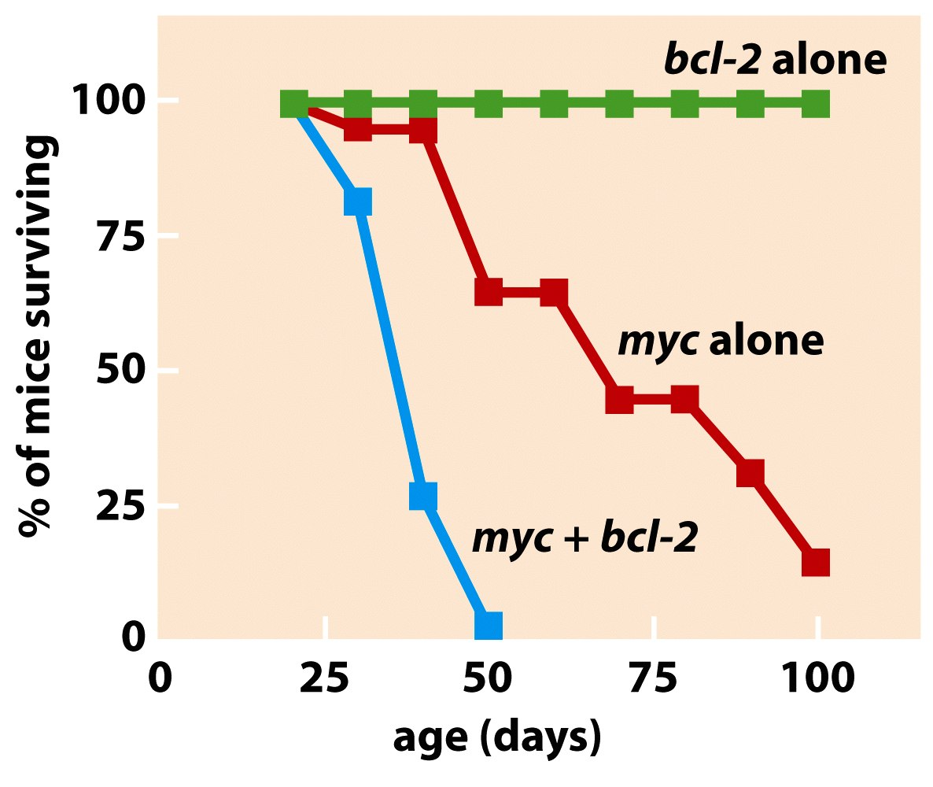
Figure 9.22b The Biology of Cancer (© Garland Science 2007)

Slide 39
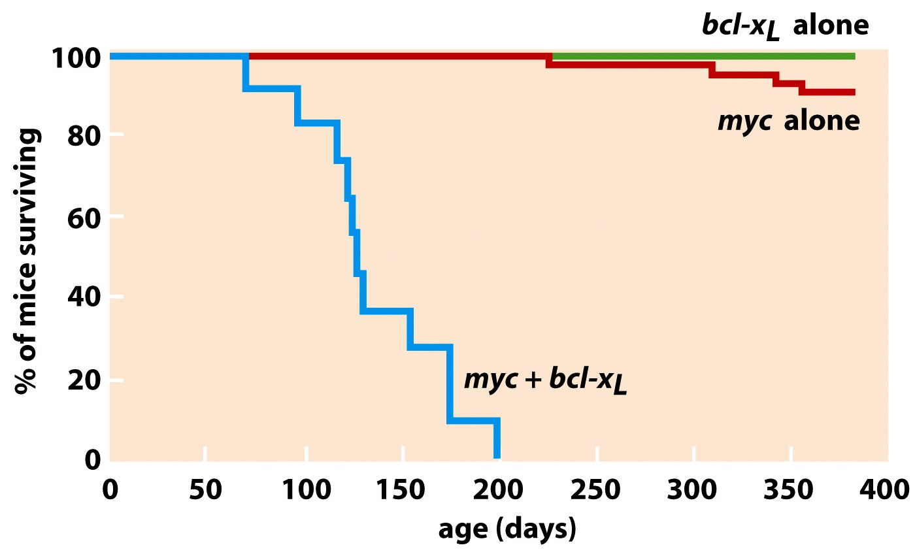
(A relative of bcl-2)

